Slide 1
Authenticated control to VMs in Xen cloud
CS526 Semester Project
By Ahmed Alharthi
&
Abdulrhman Alsahafi
CS526 Advance internet and web systems A.Alharth, A Alsahaf

Slide 2
Overview
Authenticated control to VMs in Xen cloud
Introduction
problem
Motivation
Approach
Design
Demo
Challenges
CS526 Advance internet and web systems A.Alharth, A Alsahaf

Slide 3
Introduction
Authenticated control to VMs in Xen cloud
Xen :open source, Promise Future, New research fields.
Tools:
Exciting tools for managing host and VMs
XenCenter (GUI)
SSH-based XAPI(CLI)
CS526 Advance internet and web systems A.Alharth, A Alsahaf
Notes:
But it doesn’t satisfy the users need for example education proposed

Slide 4
Authenticated control to VMs in Xen cloud
Problems:
Xen command line based needs linux account on xen host
allowing some commands are consider risky.
Privileging untrusted user.
Goal:
Limitation of privilege.
Avoid running unwanted commands(xe host-shutdown)
Allowing multiple users to control Xen
CS526 Advance internet and web systems A.Alharth, A Alsahaf

Slide 5
Authenticated control to VMs in Xen cloud
Approach:
Allows users to use xe-command without giving them Xen accounts.
Design :
Users :
End-user.
Member
Super user
Web Application:
Interact with users.
Validate user commands.
Web Server:
Hosting the Application.
Providing Shell API and Xen API.
Xen host:
controls VMs.
Executing user commands.
CS526 Advance internet and web systems A.Alharth, A Alsahaf

Slide 6
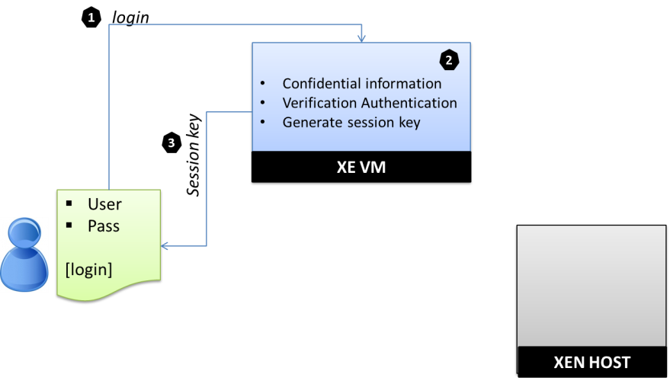
Design
Authenticated control to VMs in Xen cloud
Member → Web App: Username& Password
Web App → Member: Session key
CS526 Advance internet and web systems A.Alharth, A Alsahaf

Slide 7
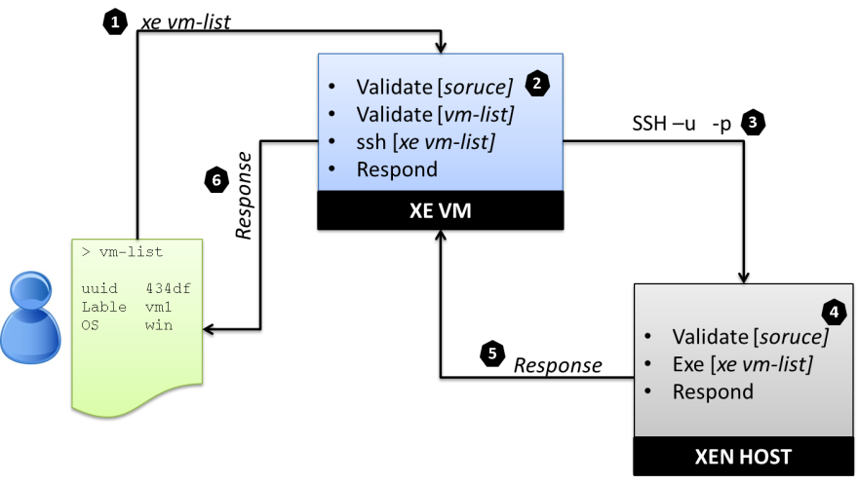
Design
Authenticated control to VMs in Xen cloud
Member → Web App: command
Web App → Xen Host: valid xe-command
Xen Host → Web App→ Member: result
CS526 Advance internet and web systems A.Alharth, A Alsahaf

Slide 8
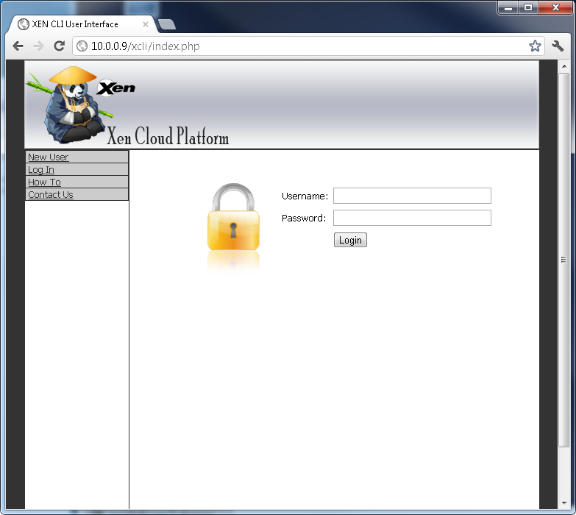
Demo
Authenticated control to VMs in Xen cloud
1. Authenticating the Member:
CS526 Advance internet and web systems A.Alharth, A Alsahaf

Slide 9
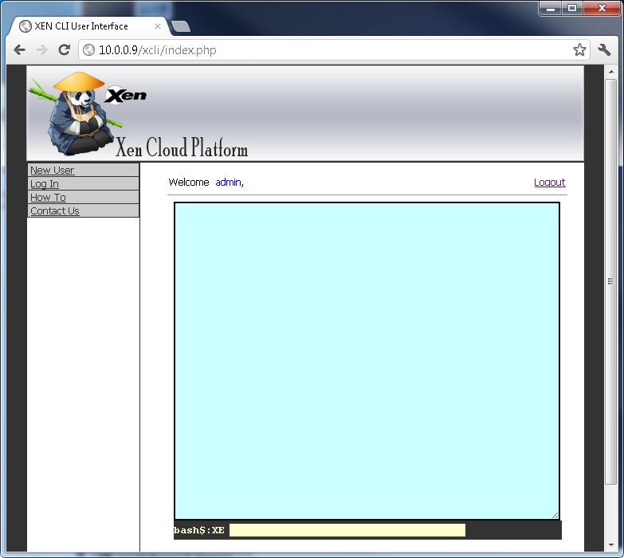
Demo
Authenticated control to VMs in Xen cloud
2. Establishing the session:
CS526 Advance internet and web systems A.Alharth, A Alsahaf

Slide 10
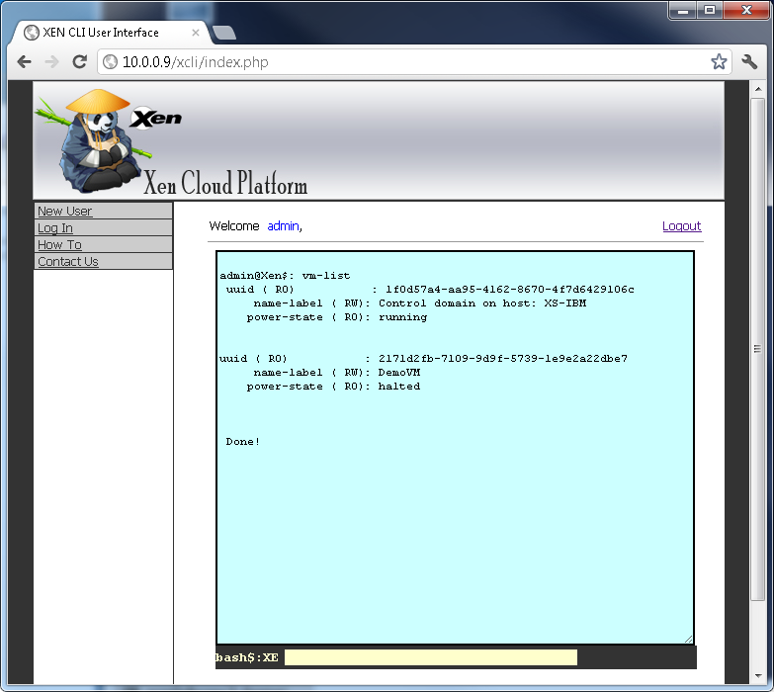
Demo
Authenticated control to VMs in Xen cloud
3. Executing XE command
CS526 Advance internet and web systems A.Alharth, A Alsahaf

Slide 11
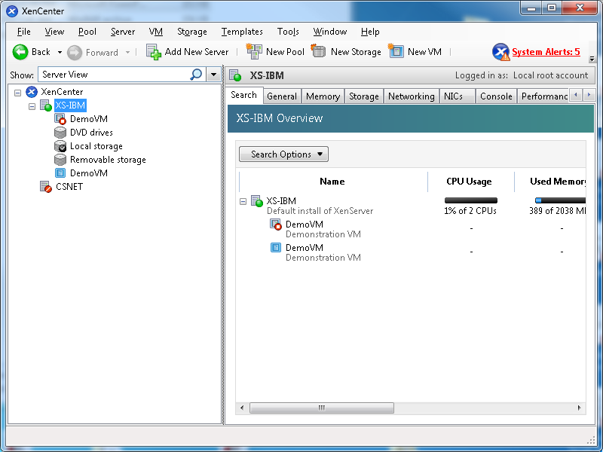
Demo
Authenticated control to VMs in Xen cloud
4. Observation
CS526 Advance internet and web systems A.Alharth, A Alsahaf

Slide 12
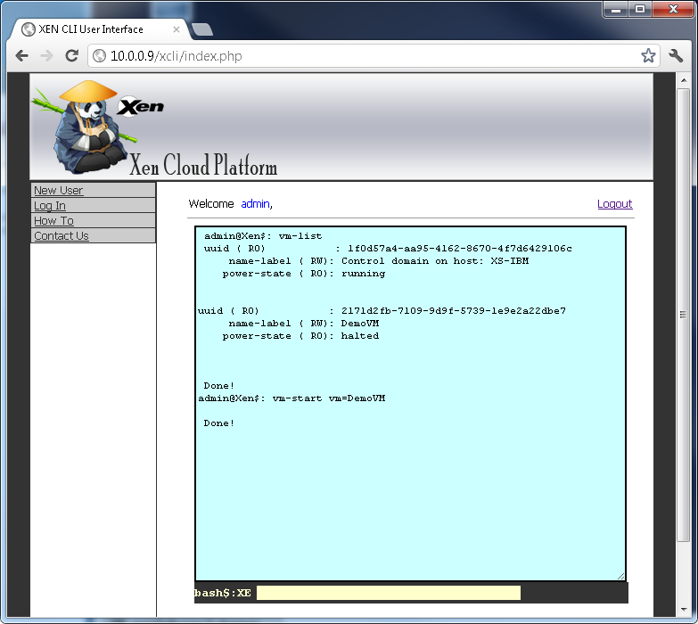
Demo
Authenticated control to VMs in Xen cloud
5. Starting VM
CS526 Advance internet and web systems A.Alharth, A Alsahaf

Slide 13
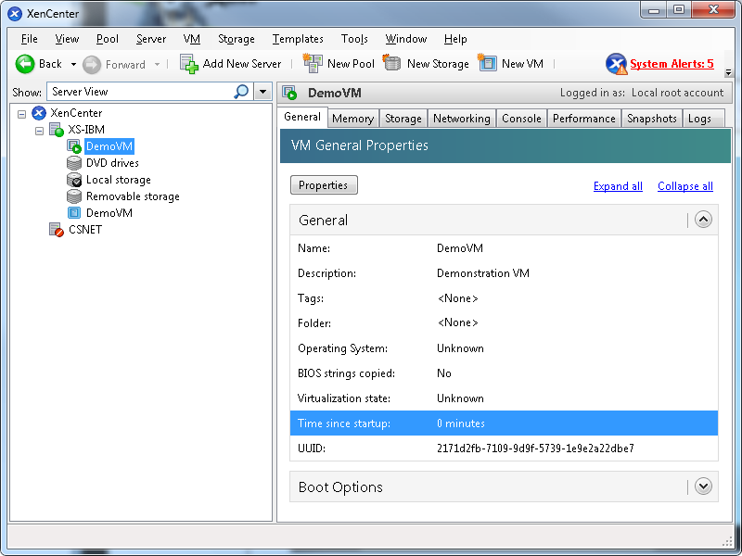
Demo
Authenticated control to VMs in Xen cloud
5. Observation
CS526 Advance internet and web systems A.Alharth, A Alsahaf

Slide 14
Challenges
Authenticated control to VMs in Xen cloud
APIs update:
The Approach API must be combatable with the new updates.
Command Validation:
Two parameters problem
CS526 Advance internet and web systems A.Alharth, A Alsahaf

Slide 15
Thanks You
Authenticated control to VMs in Xen cloud
CS526 Advance internet and web systems A.Alharth, A Alsahaf

